Slide 1

“Investigating the Parallels between using a RAT-Style Software for Malicious purposes and virtuous intent”
By Daniel Broomhead
27016005

Slide 2

What is a Rat?
Remote Administration Tool:
Virtuous
Productive
Benevolent
Benignant
Remote Access Trojan:
Promiscuous
Malicious
Deceitful
Surreptitious
At The Heart of it, they are the same ideology and technology.

Slide 3
How are RATs used?
Remote Desktops
Administration
Computers
Remote access software
Usually part of a bigger system
Delivering a payload

Slide 4
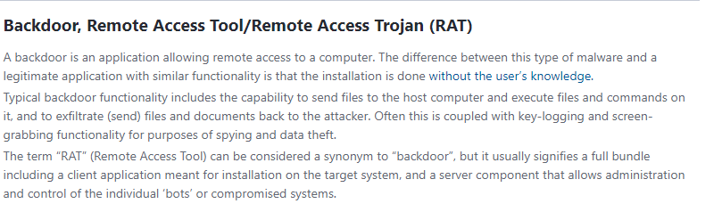
https://www.virusradar.com/en/glossary/backdoor

Slide 5

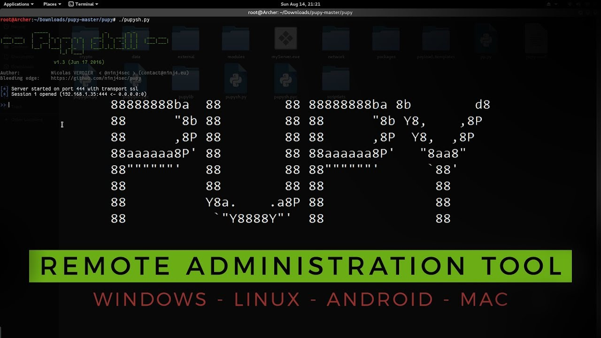

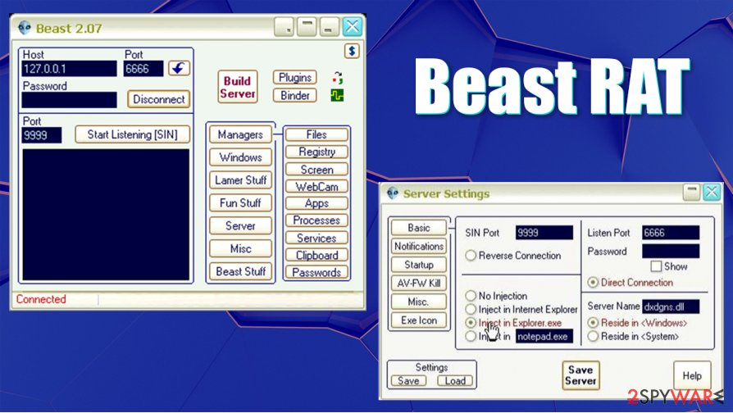
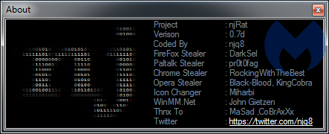
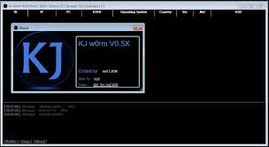
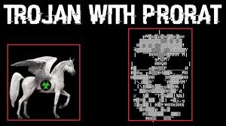

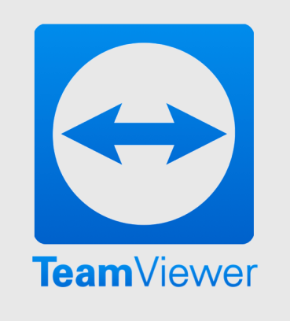
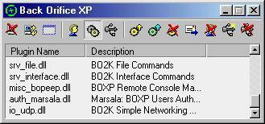
Examples:
Notes:
Beast = Delphi
PuPy – Crossplatform Python
NJ/ KJ JRAT - Java

Slide 6
General Considerations for Rats:
Language:
Methodology:
System:

Slide 7
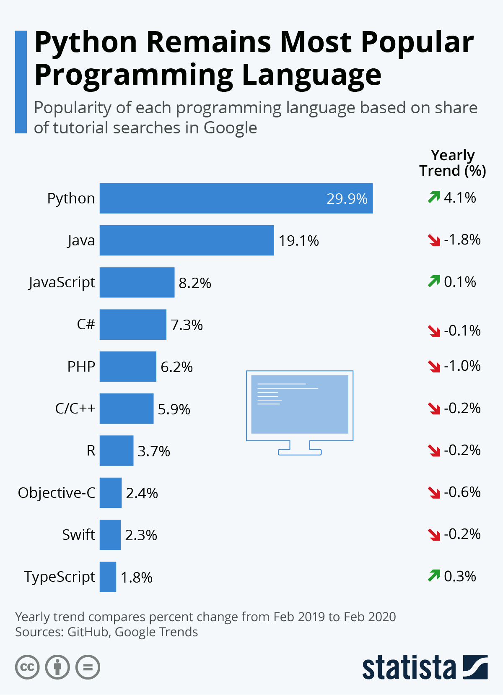
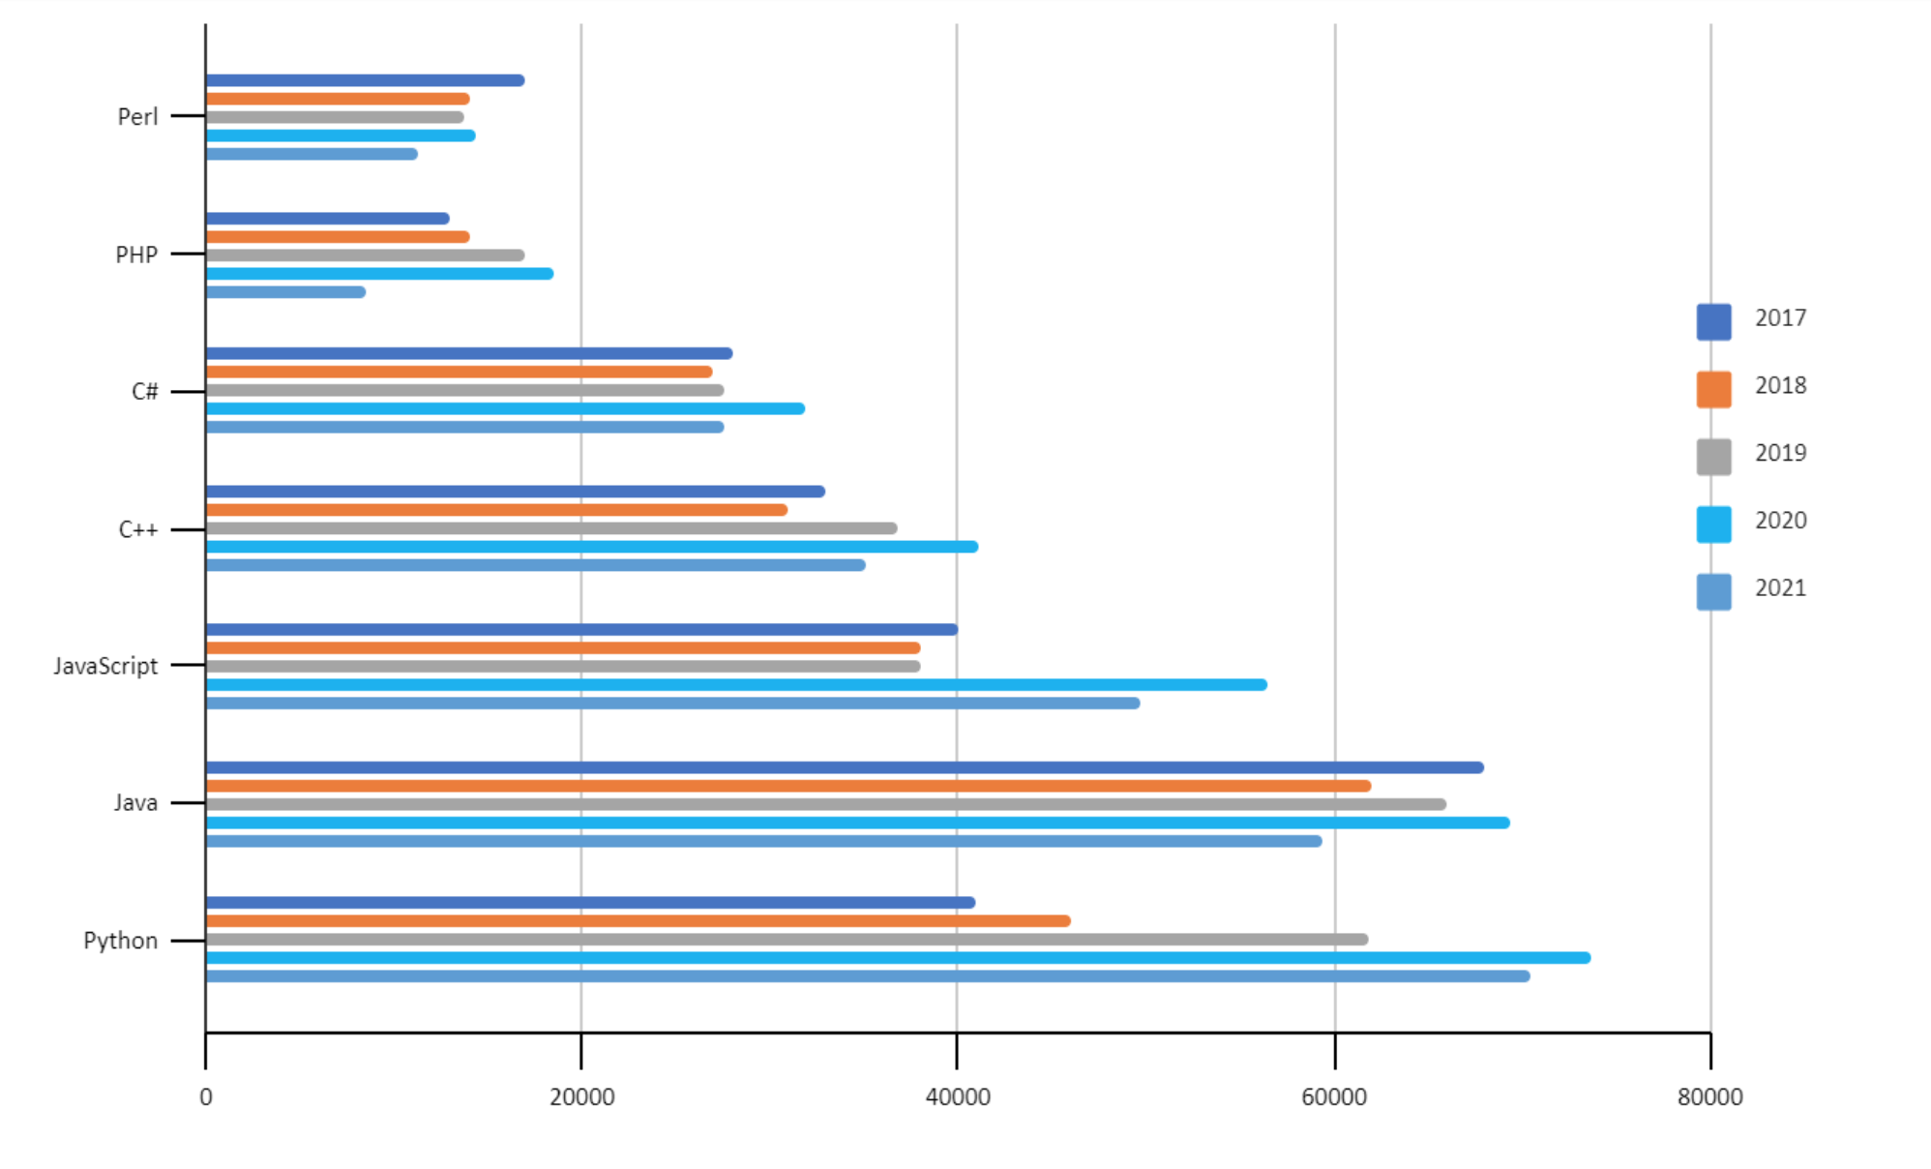
Python 3:
Python 2 is now deprecated.
Cross-Compatibility :Compatible with all major Platforms and Systems
Robust Standard Library
Depth of open-source frameworks, Extended libraries, community support
Effective in the IoT sphere
Tried & Tested Scalability
Python is a desired Language in the workplace – so this will be a good project to demo
Gaining popularity faster than ever
Fairly confident in this language but looking to develop skills further

Slide 8
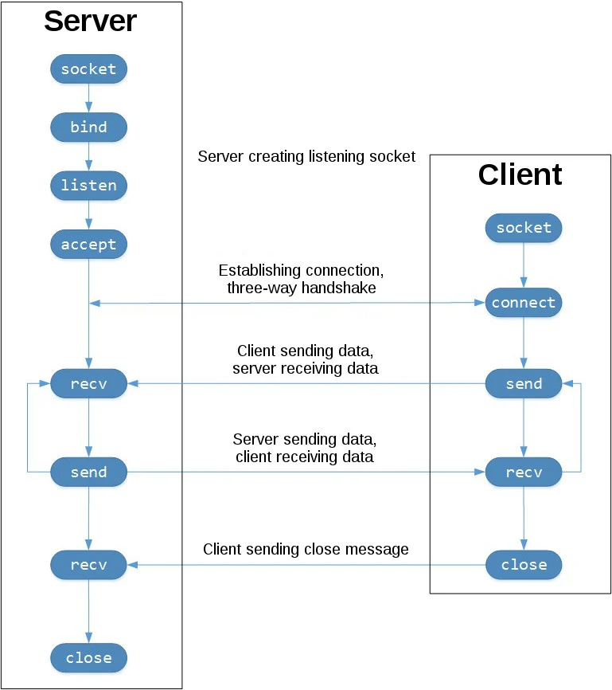
My Rat: The Crucial Decisions
Using the Python Socket module as an interface to the Berkeley Sockets API
TCP Sockets
Reliable: Dropped Packets retransmitted – no data lost
In-order: Data is read in the order it was written
UDP Does not share their properties and thus would not be appropriate.
A reverse connection is also used meaning the client initiates the connection with the server.
This prevents the firewall from blocking the connection as it sees the connection as being instantiated from within.
This has been developed on Windows 10
Mainly for use on Windows 10
Some of the features may work on Linux, No testing has been conducted on MacOS

Slide 9
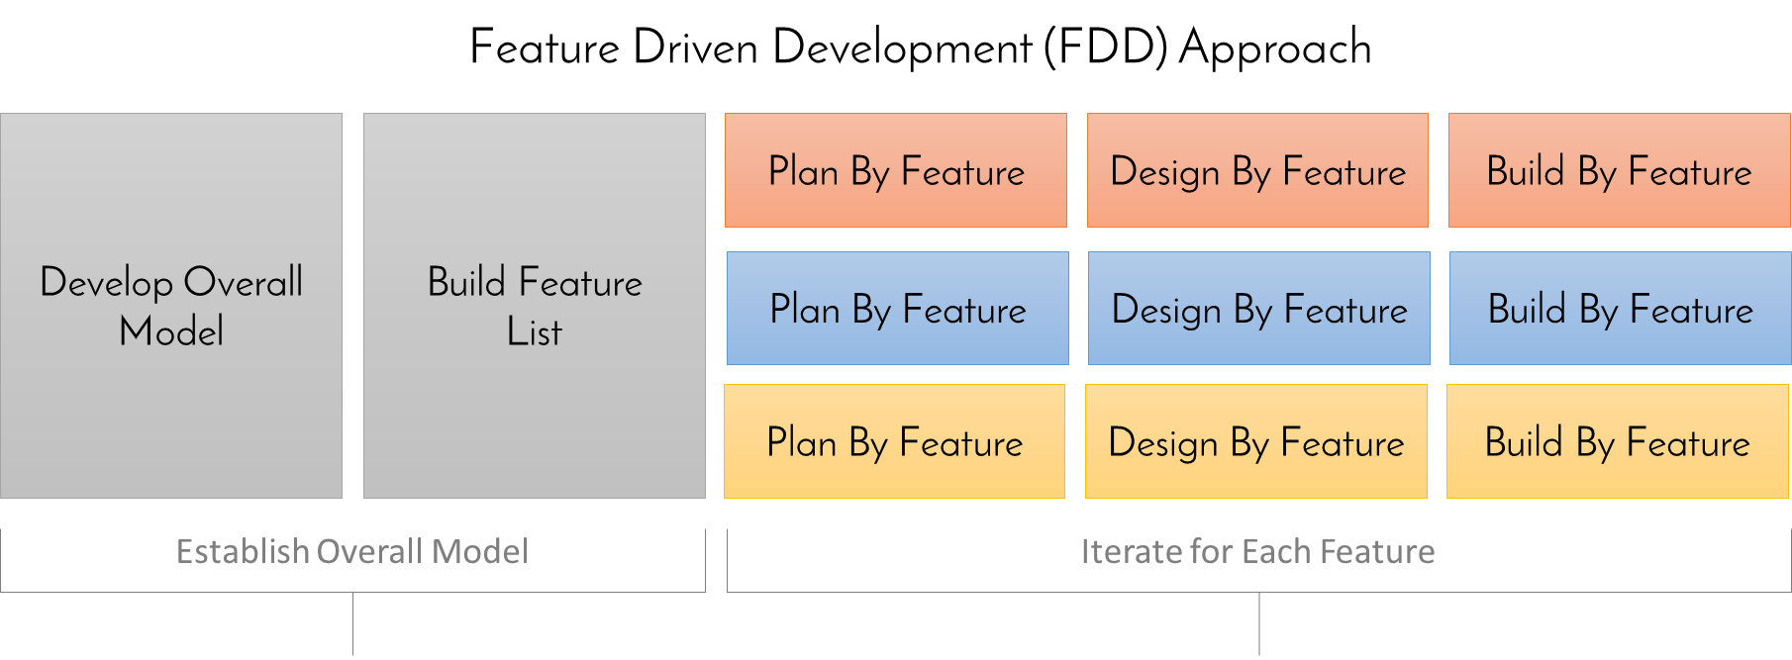
Development ideology
The development of the functionality for the system followed a similar ideology to that of Feature driven development

Slide 10
For each Feature:
Research
Plan
Design
Isolated Build & Testing
Integrated Build & Testing
Fully integrated Deployment
Functionality
Applying to a simplified Socket
Integrating with the Live Build

Slide 11
Current Functionality:
self.Switcher = { "-msgbox": self.systemmsg, "-msg": self.sendMsg, "-shutdown": self.shutdown, "-shutdownM": self.shutdownmessage, "-lock": self.locksystem, "-restart": self.restartsystem, "-EpIV": self.playstarwars, "-chess": self.playchess, "-weather": self.weather, "-telnet": self.enableTN, "-KLstart": self.startKeyLogger, #"-KLend": self.stopKeyLogger, "-getLogs": self.getKeyLogs "-getcb": self.getClipBoard, "-Fsend": self.filesend, "-Frecv": self.filereceive, "-ginfo": self.getTargetInfo, "-exe": self.exePy, "-ss": self.screenshot, "-vid": self.vidByFrames, "-shell": self.cmdctrl, "-email": self.email, "-dailymail": self.startEmailthread, "-endmailer": self.stopEmailThread }
Send a console message
Send a custom messagebox Alert
Remote Shutdown (+ Remote Shutdown with custom message)
Remote Lock Device
Remote Restart
Play Starwars Via Telnet Connection
Play Chess Via Telnet Connection
Check the Weather Via Telnet Connection
Enable Telnet Client
Start Keylogger → Stop Keylogger
Retrieve Keylogs
Retrieve Clipboard Contents
Send a File
Retrieve a File / Folder
Obtain information about the target system
Execute a file
Screenshot
Series of screenshots → Video
Reverse shell
Send an email
Auto emailer – start /stop
Record Webcam
Playback recording

Slide 12
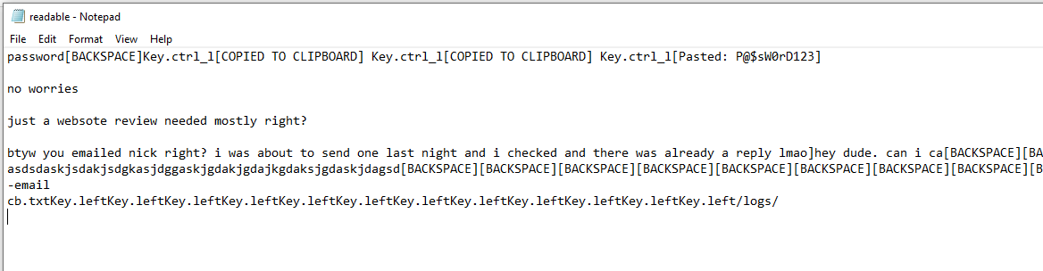
Key Logger:
Runs on separate thread
Capture Ctrl+C, Ctrl+V shortcuts for copy and paste
Creates a hidden text file to store the contents and be retrieved at another time
Captures Clipboard contents
Runs in the background.
Invisible

Slide 13
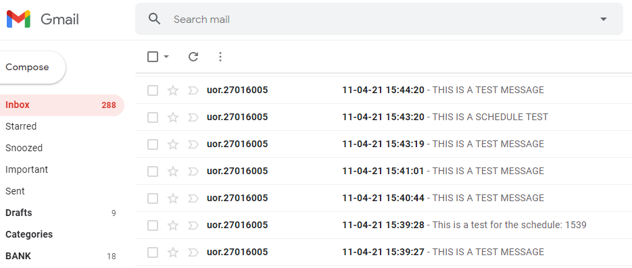
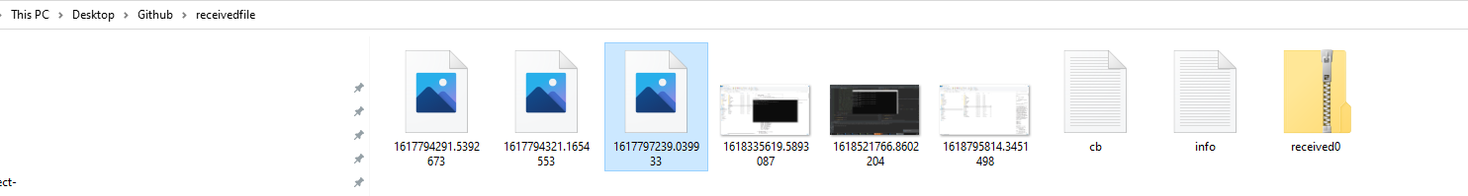
File contents Sent via email. Including for a Scheduler automailer
Files Transmitted Via TCP Sockets:

Slide 14
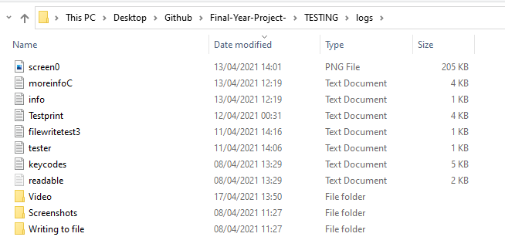
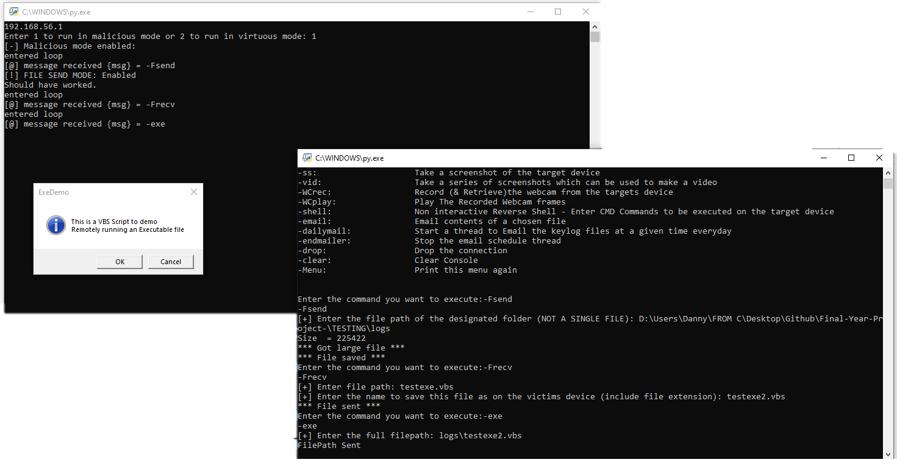
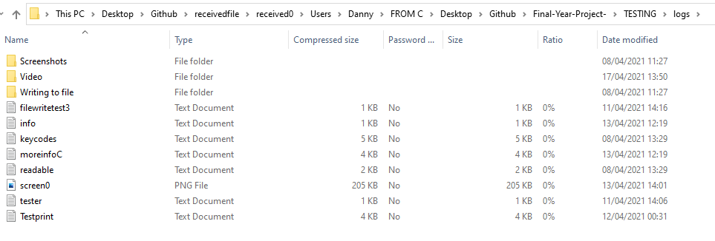
Directory on Client:
Client: :
Server: :
VBS Script running on client
Move file from client to server
Move and rename script from server to client
Run transferred script on client
Directory on server:

Slide 15
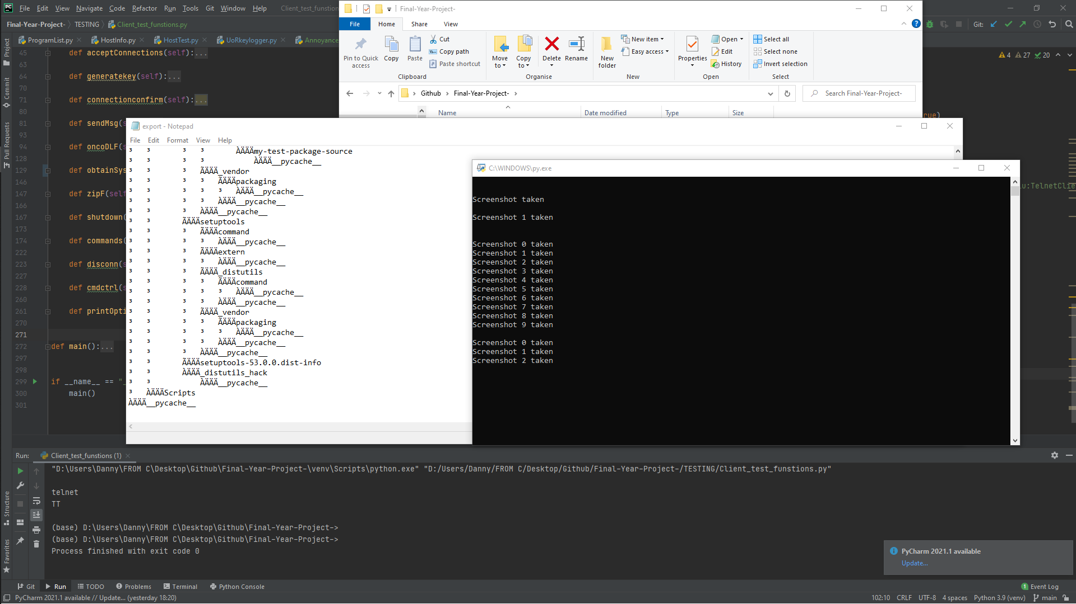
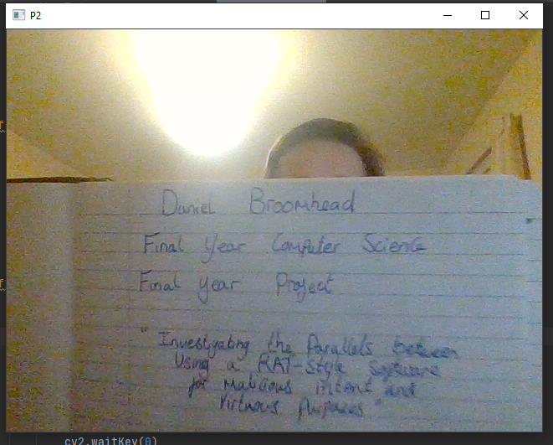
Capture taken from target’s webcam
Screenshot taken from victims device

Slide 16
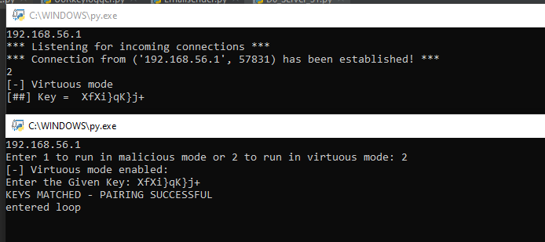
SERVER:
CLIENT:

Slide 17
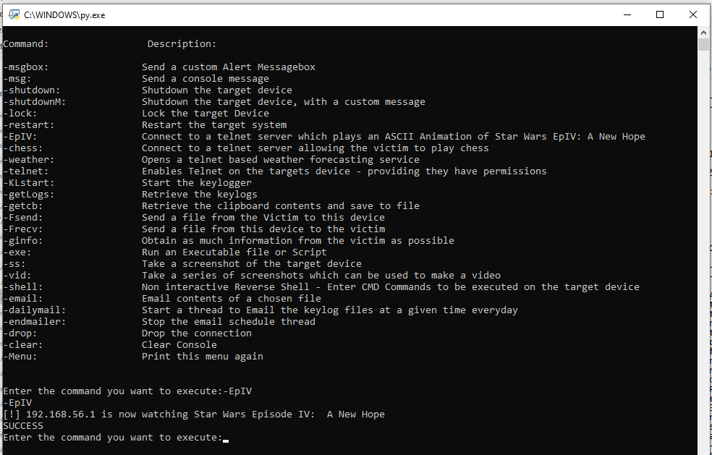
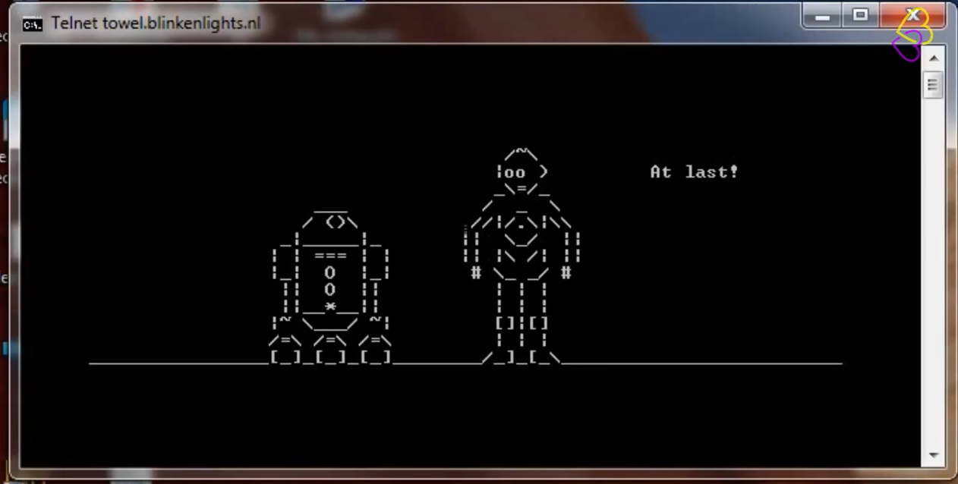

Slide 18
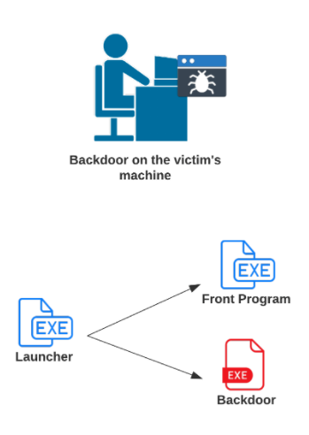
The generated executables
PyInstaller used to generate a packaged executable
Executable then taken from maze game
Create a script which launches the front program(Maze) and a threaded daemon for the client side of the RAT
Create an executable from this script.
All 3 executables needed on client device.
Need to be in designated file paths specified in launcher.py

Slide 19
Dependencies
D0_Wclient_31.py
socket
Sys
subprocess
Os
Platform
threading
Time
Datetime
Cv2
mss
Zipfile
Pprint
Schedule
Smptlib
Pynput
pyperclip
D0_Wclient_31.exe
NONE – Not even python needed
D0_Server_31.py
socket
sys
os
time
random
string
cv2
Zipfile
When Converting to an .exe using Pyinstaller, all dependencies can be included meaning the program will run standalone.
Launcher.py
Sys
Os

Slide 20

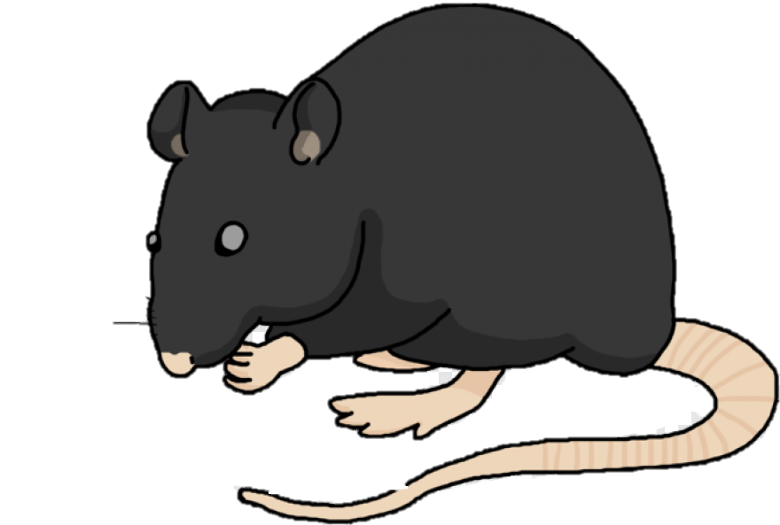
What Does UoRat Offer?
Lightweight,
Fast,
OpenSource,
Free,
Easy to use,
Easy to modify and expand
Effective

Slide 21
Conclusion:
Fully Functional,
Scalable & Extendable,
All Objectives Achieved,
Results correct to intended purpose,
Reliable,
Complete,
More emphasis could have been placed on UI and aesthetics.

Slide 22


Who am I?
Daniel Broomhead
27016005
R. U. Hacking? Society President
BCS Berkshire Student Chapter President
BCS Berkshire Early Careers Advocate
BCS Open Source Specialist Group – Young Representative
On track for BSc(Hons) Computer Science – First Class

Slide 23
Supplementary Slides:

Slide 24

Future Functionality & Ideas:
Graphical user interface : either fully interactive or a graphical design made in console using ASCII art.
More effort into aesthetics
Time out feature: Session terminates after extended period.
Only required on virtuous version
More emphasis placed on the Virtuous style software
More research into RDP
Other Desktop Protocols
More support for other operating systems
EVEN MORE FUNCTIONALITY

Slide 25
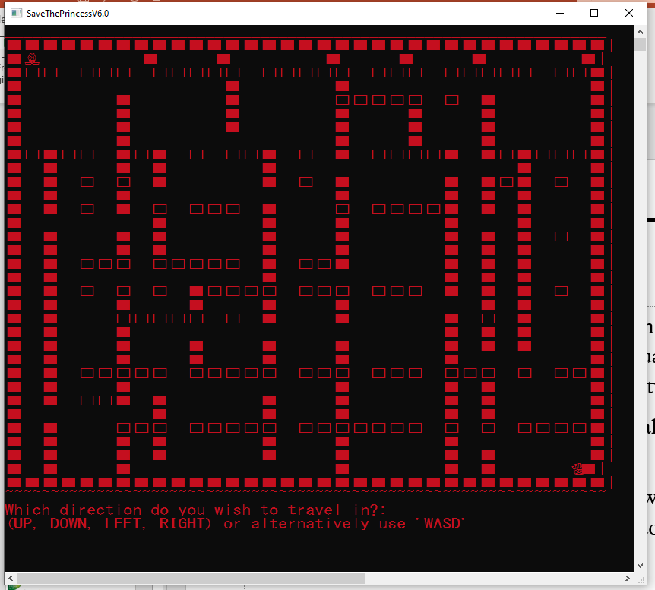
About the demo:
In the demo – the python script is used which generates a console output for both client and server is used. When used in a real world situation, the client console will not be visible as the purpose of this program is designed to be virtually invisible.
For similar reasons, files which would normally be removed from the system have been left for viewing purposes.
The maze front end program will not be shown in the demo, as it is not the main focus of the project, and more of a disguise and method to get the client on to the target’s system.
The maze program is created in C++ and uses a recursive algorithm to generate a random maze.
The Shutdown, lock and restart features are also not demonstrated as it is not possible to captures these with screen recording software.

Slide 26

Glossary & Terms:
RAT : Remote Access Trojan / Remote Administration Tool
TCP : Transmission Control Protocol
UDP : User Datagram Protocol
OOP : Object Oriented Programming
OOD : Object Oriented Design
FTP : File Transfer Protocol
UI : User Interface
GUI : Graphical User Interface
RDP : Remote Desktop Protocol

Slide 27
THE DEMO:

